Slide 2
Purpose
In the first part of this document we are going to show through two different procedures, the size of our app and the estimated cost.
In the second part instead we are going to show the project tasks and their relative division during the project.
In the last part we will show our risk project management.
How did we do this?
Functional Points
COCOMO II
Task chart diagram

Slide 3
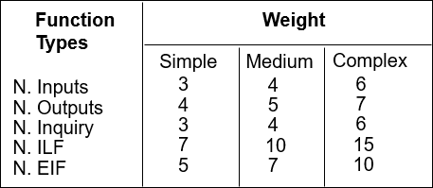
Section 1
Functional Points
A function point is a "unit of measurement" to express the amount of business functionality an information system provides to a user. Function points measure software size. The table below shows the weights values that we have used to calculate the FP value.
We have used this table to find the functional points of our app.

Slide 4
Section 1
In particular:
We have taken into consideration these aspects:
Internal Logic Files (ILFs)
External Logic Files (EIFs)
External Inputs (EIs)
External Inquiries (EIQs)
External Outputs (Eos)
It’s a user identifiable group of logically related data that resides entirely within the application.
It’s a user identifiable group of logically related data that is used for reference purposes only.
It is an elementary process in which data crosses the boundary from outside to inside.
It‘s an elementary process with both input and output components that result in data retrieval from one or more internal logical files and external interface files.
It is an elementary process in which derived data passes across the boundary from inside to outside.

Slide 5
Aspect | Total cost | Description
Internal Logic File | 56 | The application stores information about: Users, Drivers, Requests, TaxiQueue, Taxis and Locations.
External Logic File | 10 | The application has to manage the position of each taxis from an external service based on GPS locations
External Inputs | 26 | The application has to manage all the interactions between users and driver.
External Inquiries | 13 | The application allows a user to view the number of taxi available in his zone according to his phone GPS location and the application allows a driver to view the pending user’s requests in order to confirm them.
External Outputs | 0 | There is no external output
TOTAL | 105 | we can hypostasize the size of the project in terms of lines of code. LOC = 105 * 46 = 4830 Lines Of Code.

Slide 6
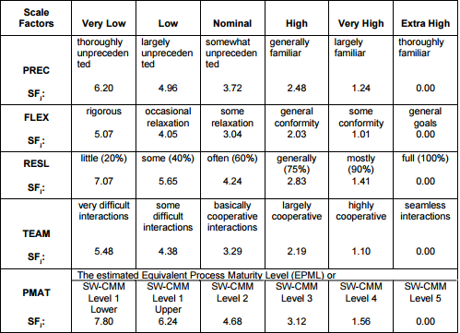
Section 1
COCOMO II
COnstructive COst MOdel II is a model that allows one to estimate the cost, effort, and schedule when planning a new software development activity. .
We have used this table for the first part and all the other table relative to the different aspects found in the manual of this model.

Slide 7
In particular:
Aspect | Incidence | Value | Description
PRECEDENTNESS | Very low | 6,20 | It reflects the previous experience in past project like this. For us, this kind of project is the first in our life we are doing and that’s why this value will be very low.
DEVELOPMENT FLEXIBILITY | Very high | 1,01 | It reflects the degree of flexibility in the development process. The professor left us a large space of flexibility without forcing us with too much details, that’s why this value is going to be very high.
RISK RESOLUTION | Very high | 1,41 | According to our project risk management.
TEAM COHESION | Very high | 1,10 | It reflects how well the development team know each other and work together. At the beginning of the project we didn’t know each other and both of us did not know how the other worked. Although this aspect, we hadn’t any problems on work’s organization and division of tasks. Due to these considerations, this value will be very high.
PROCESS MATURITY | High | 3,12 | There are two ways of rating Process Maturity. We have chosen the second that s organized around the 18 Key Process Areas (KPAs) in the SEI Capability Maturity Model. We can consider this value as high.
TOTAL |  | 12,84

Slide 8
Driver factor | Incidence | value
Required software reliability | Very high | 1.26
Database size | High | 1.00
Product complexity | Nominal | 1.00
Required reusability | High | 1.07
Documentation match to life-cycle needs | Nominal | 1.00
Execution time constraint | Very low | n/a
Main storage constraint | Very low | n/a
Platform volatility | Low | 0.87
Analyst capability | Very high | 0.71
Personnel continuity | Very low | 1.29
Application experience | Low | 1.10
Platform experience | - | -
Programmer capability | - | -
Language and tool experience | - | -
TOTAL (PRODUCT) |  | 1.18

Slide 9
Section 1
Effort estimation
The final equation gives us the effort estimation measured in Person-Months (PM)
Effort = A * EAF * KSLOCE
The values of A, B, C, and D in the COCOMO II.2000 calibration are:
A = 2.94 B = 0.91
C = 3.67 D = 0.28
EAF is the product of all the cost drivers that is equal to: 1.18
KSLOC represents the estimated lines of code obtained from the FP analysis: 4830
E is the exponent derived from the Scale Drivers with the equation below:
B+0.01* sum{i} SF[i] = 0.91 + 0.01 * 12.84 = 1.0384
With all of these parameters we can calculate the final effort:
Effort = 2.94*1.18*4.830^{1.0384} = 17.8008 PM

Slide 10
Section 1
Shedule estimation
We are going to use this formula to compute the estimated duration:
Duration := 3.67 * Effort^{F}
Where F = 0.28 + 0.2 * (E-B) = 0.28 + 0.2 * (1.0384-0.91) = 0.3057
So → Duration = 3.67 * 17.8008^{0.3057} = 8.84 → 9
The duration estimated by these computations is not similar to how the reality is. It is also truth that in our project we had just to do the documentation. Probably if we were to do also the implementation and development of the entire application, the duration of the global project could be about 9 months.
P = Effort/ Duration = 17.8008/9 = 1.98 → 2

Slide 11
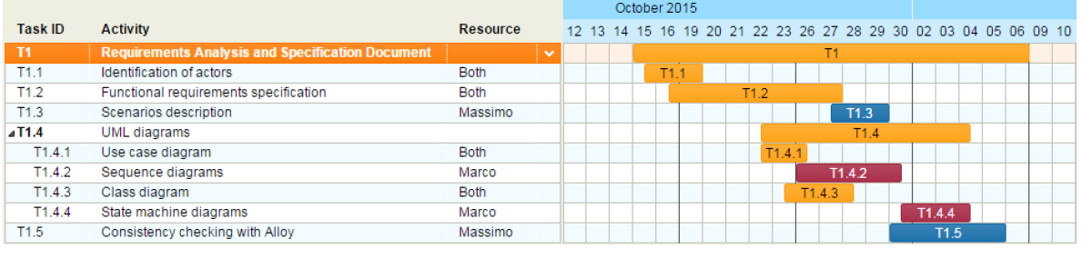
Section 2
Task chart diagram
On the right part of the diagram we can find a list of task for the Requirements Analysis and Specification Document, on the left it’s shown the «work in progress» during the project period.

Slide 12
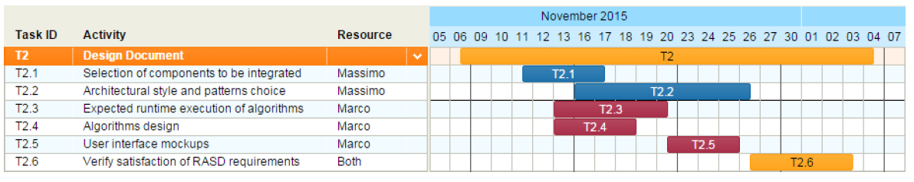
Section 2
Task chart diagram
On the right part of the diagram we can find a list of task for the Design Document, on the left it’s shown the «work in progress» during the project period.

Slide 13
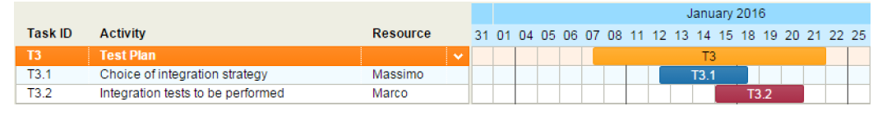
Section 2
Task chart diagram
On the right part of the diagram we can find a list of task for the Test Plan, on the left it’s shown the «work in progress» during the project period.

Slide 14
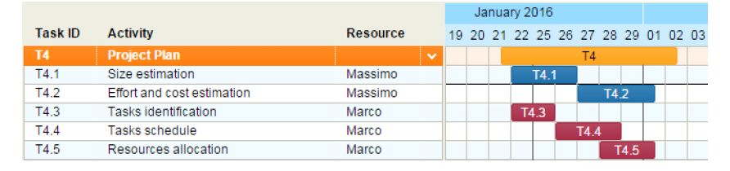
Section 2
Task chart diagram
On the right part of the diagram we can find a list of task for the Project Plan, on the left it’s shown the «work in progress» during the project period.

Slide 15
Section 3
Project risk management
Risk | Probability | Effect | Strategy
The database used in the system cannot process and manage all the transactions per second as expected | Moderate. It depends on how much the application will be used in the market. | Serious. The system can go down and cannot process some requests from the users | Alert the customer when the capacity of database is running out fast. Two alternatives: Delete the oldest data. Adding a new database to the system.
The server has a data overload. | Low. This risk has a pre-strategy used to manage it because tests about stress were done. | Catastrophic. If this case occur, the entire system goes down not only by processing the last requests but it is also impossible to access into the system while the system is still down. | This can happen principally during the rush hour. It is useful to increase the server capability during these hours.

Slide 16
Risk | Probability | Effect | Strategy
A user’s request considered by him as sent, it is actually never been sent due to a network error. | Low. This can happen only if people are in a place with little cellular coverage. | Serious. A user believes he has sent a request, but in reality, it is not true. | Force a minimum cellular coverage to all the users for using correctly the application.
Market risk. This is meant as the possibility to not have an expected number of downloads due to the age of the population in relation to those who use the service. The teenager and the part of the population that is young, use much more the railways services than the taxi. | Moderate. This risk can be taken into consideration based on what the city is smart. Integrate a service like this in a city whose population is old would make little sense. | Moderate. Probably the money coverage spent on the project will has much time to be regained. | It is useful to study accurately the target population before staring to develop the app. It is a good thing make a survey by which obtain the habits of the citizens.

Slide 17
Risk | Probability | Effect | Strategy
People risks. This is associated with the availability, skill level, and retention of the people on the development team. Probably it could be useful to have a programmer and a designer in our team. | High. | Low. Probably the absence of these two figures mean a low palatability level of the application in terms of design. The functional use of the application is anyway guaranteed. | The customer can inform about these two figures to include in the project team only during the development part according of course to the estimated cost.

